Slide 1

Let’s talk about the past!

Slide 2

When we talk about the past, we can tell about activities we did on regular basis. Activities we did frequently, repeatedly, again and again.
We use “used to” with the infinitive (to+verb) to say that something regularly happened in the past, but no longer happens now.

Slide 3

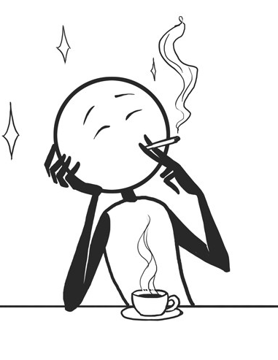
Let’s take a look at Daniel
This is Daniel a few years ago.
He used to smoke 20 cigarettes a day.
“He used to smoke” means that he smoked regularly (repeatedly) for some time in the past.

Slide 4
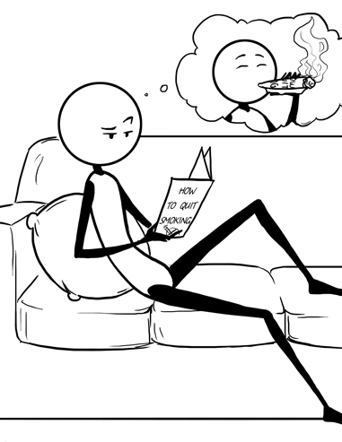
This is Daniel, 2 years ago
He was worried about his health.
He decided to quit smoking.
He looked for help.
He knew he had to stop smoking for his own good.

Slide 5
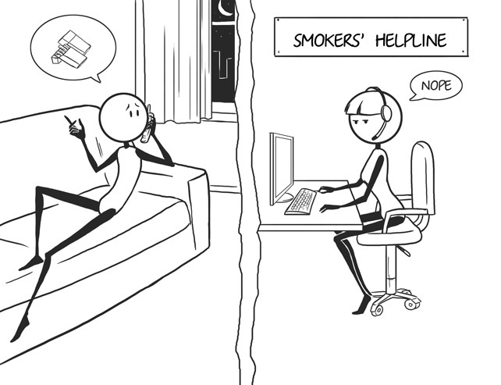
Sure!
Daniel really wanted to stop smoking, so he looked for help!
He could stop smoking… because he accepted some help!!!

Slide 6
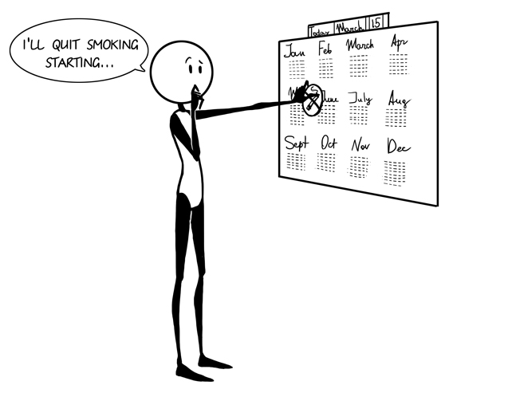
So, after looking for help, he made a hard but firm decision.
No more smoking.

Slide 7
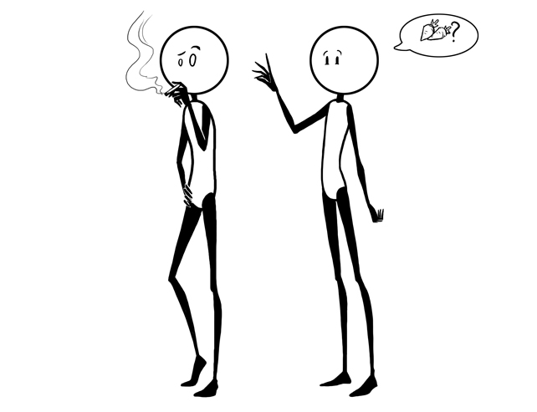
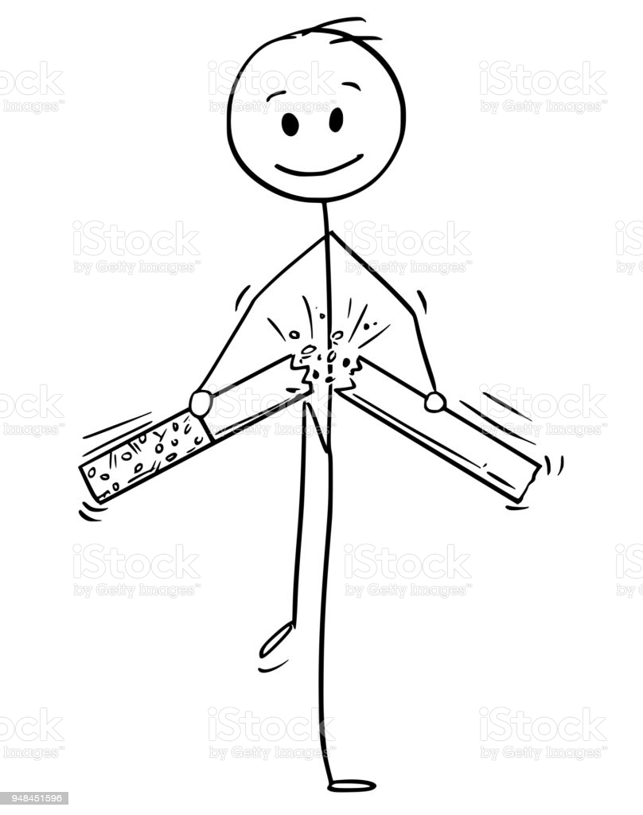
This is Daniel today.
Now, he advices his friends not to smoke anymore.
Because he gave up smoking 2 years ago, he feels better.
He no longer smokes.

Slide 8

Let’s take a look at his timeline:
So, he no longer smokes.
Past ----------------------------------------------------------------------------------------------------------------------- Now
A few years ago
-------------------------------------------------------------------------------------------------------------------------------------
He used to smoke 20 cigarettes a day He doesn’t smoke now
For a period of time.
He stopped here
He hasn’t smoked for the last 2 years.
(Repeated action)
(exactly 2 years ago)

Slide 9
I used to play tennis a lot, but now I’m too busy.
Tom used to travel a lot. These days he doesn’t go away very often.
Do you go to the movies very often? – Not now, but I used to.
When I was a child, I used to go to the playground with my siblings.
As a child, I used to eat a lot of candy. Now, I don’t.
So
Let’s review!
We use “used to” to say that something happened “regularly” in the past, but not anymore.

Slide 10
We used to live in a small town but now we live in this city.
This building is now a furniture store, it used to be a cinema.
Do you see that hill over there? There used to be a tower on that hill.
I’ve started drinking coffee recently. I never used to like it before.
Ann used to have long hair but she cut it last week.
We also use “used to” for past situations (which no longer exist)

Slide 11
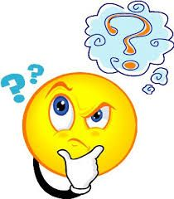
What is the Grammar structure ?
Remember: “used to” is past tense.

Slide 12
We form “used to” by using:
Verb:
eat
drink
dream
sleep
work
write
go
walk
travel
Subject:
I
You
We
They
He
She
It
used to
+
extra information

Slide 13
We form “used to” in a negative way by using:
Subject:
I
You
We
They
He
She
It
Verb:
study
watch
work
get up
see
cook
talk
look
visit
didn’t
use to +
+
extra information
(This is past tense, so when you use the negation, you use the auxiliary “didn’t” and the verb in simple form)
(Notice that the verb is in simple form “use”)

Slide 14
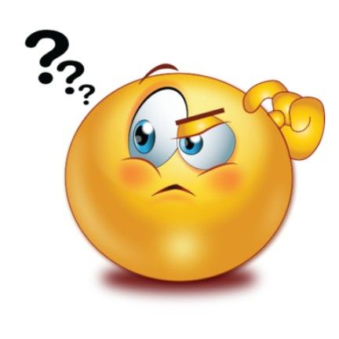
How do we ask questions?
Remember: it’s past tense, so we use the auxiliary “did”

Slide 15
We ask questions with “used to” by using:
Subject:
I
you
we
they
he
she
it
Verb:
study
watch
work
get up
see
cook
talk
look
visit
Did
?
use to
+
extra information
(question mark)
(Remember the verb in simple form “use”)

Slide 16

Let’s see some examples of Yes/No questions:
Did you use to play hide and seek with your friends?
Did they use to study the day before the exam?
Did your parents use to take you to school?
Did Mary use to swim in the river when she was a child?
Did you use to go out a lot?

Slide 17

Now, let’s see some examples of information questions:
Who did you use to play hide and seek with?
What did you use to eat as a child?
Where did your parents use to take you on vacation?
What did Tom use to watch on TV when he was a child?
Where did you use to play?

Slide 18

Also, when we talk about something that happened in the past, we can use: ‘would’ (Technically, would is the past tense of will)
Examples:
We can use ‘would’ to talk about repeated past actions that don't happen anymore.
Would is not use to talk about past states.
Never use it with verb “be”
When I was a child, I would go on a long bike ride every Saturday
My dad would read me amazing stories every night at bedtime.
‘would’ for past habits is the same meaning than used to, but more formal. It is often used in stories. We don't use the negative or question form of would for past habits, only ‘used to’.
Note that we can't usually use ”would” to talk about past states (not with “Be”)
Note: If something happened only once, we must use the past simple.
- Example: We went to Europe in 2014.

Slide 19
We can always use the past simple as an alternative to ”used to” or ”would” to talk about past states or habits. The main difference is that the past simple doesn't emphasize the repeated or continuous nature of the action or situation. Also, the past simple doesn't make it so clear that the thing is no longer true.
- We went to the same beach every summer. - We used to go to the same beach every summer. - We would go to the same beach every summer.

Slide 20
IMPORTANT NOTES:
USED TO + INFINITIVE (TO+VERB) IS ALWAYS “PAST”. THERE IS NO PRESENT.
You cannot say: “I use to go to bed early”
Be careful, do not confuse “I used to do” and “I am used to doing”. The structure and meaning are different.
I used to live alone (meaning: I lived alone but I no longer live alone)
I am used to living alone (meaning: I live alone and I don’t find it strange or new because I’ve been living alone for some time)
(incorrect)
Look:
(this is past)
VS:
(this is present)

Slide 21
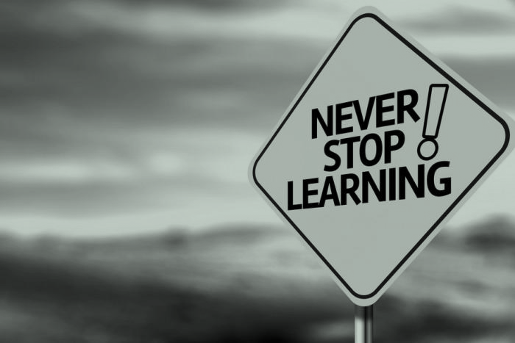
Practice: Complete with the correct form of “used to”.
When I was child, I ___________ (go) swimming every day.
Ronald ______________ (go) to sleep early, he was a nurse and he had the night shift. Now that he is retired, he goes to sleep early.
I ___________ (practice) roller-skating. It was one of my favorite hobbies to share with my friends.
Greg __________ (drink) a lot of coffee when he was a university student. Now, he prefers tea.
Susan moved from a big house to a small house. She is going to miss living in a big house.
She ______________ (have) a lot of space.

Slide 22
Practice: Complete with the correct form of “used to”.
didn’t use to wear
When I was a child, I _____________ (wear) glasses. Now I do.
Thomas lives in USA now. He moved there 2 years ago. He misses his mom’s cooking. He ____________ (eat) “gallo pinto” every day for breakfast. Now, he doesn’t anymore.
I ______________ (tell) people what to do. I was the boss in a big company.
___did__ you _________ (have) long hair when you were younger?
_______ your father ____________ (work) when he was a child?
used to eat
used to tell
use to have
Did
use

Slide 23


Great job!
And don’t smoke please!

